Slide 1
A Plea Regarding “Liberal”
By Daniel Klein, Econ & Mercatus, GMU, & Ratio Institute, Stockholm

Slide 2
Apology to friends on the left

Slide 3
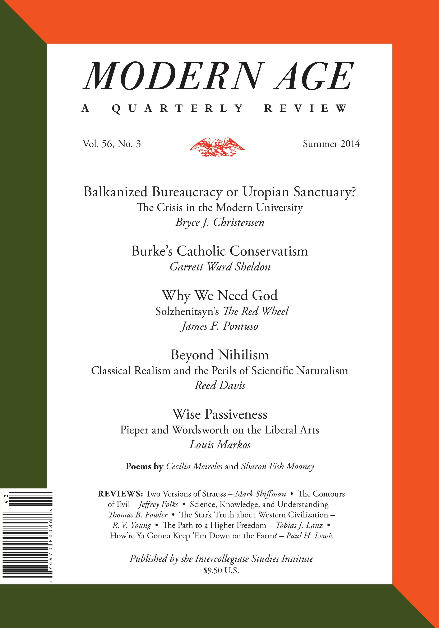

Slide 4
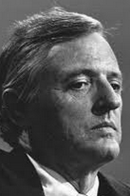
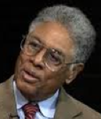
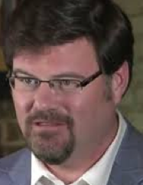
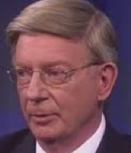
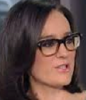
Dear addressees

Slide 5
The plea
Please don’t call leftists, progressives, social democrats, or Democrats “liberals.”
Instead, use those other terms.
Or:
so-called liberals
“liberals”
left-liberals

Slide 6
Option A: Stand pat.
Option B: Don’t call leftists “liberals.”
Option C: Also, call yourself “liberal.”
The plea is only Option B.

Slide 7
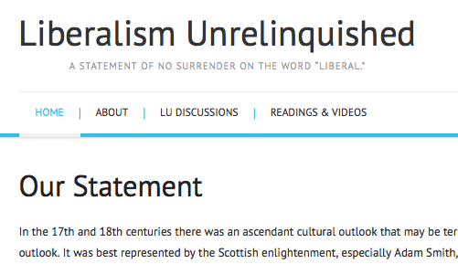

Slide 8
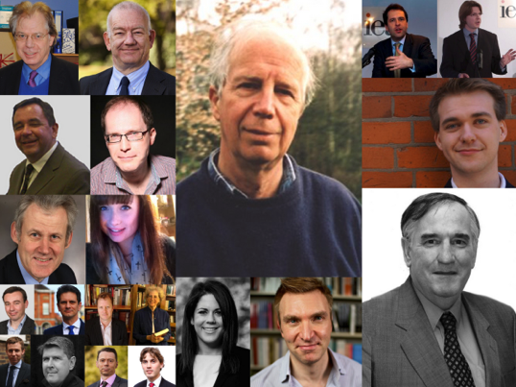
UK signers include

Slide 9
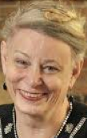
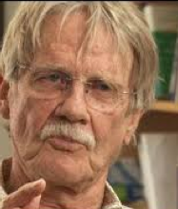
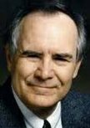
Some US libertarian-ish signers

Slide 10
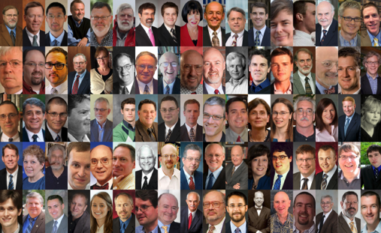
More US libertarian-ish signers

Slide 11
Jonathan Haidt

Slide 12
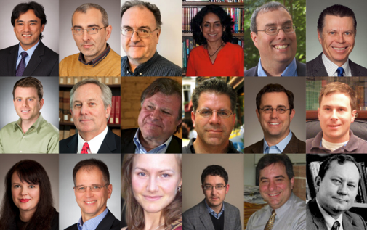
GMU signers

Slide 13
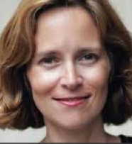
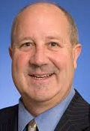
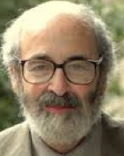
US conservatives/classical liberals

Slide 14
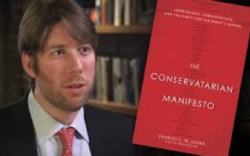
Charles C.W. Cooke, Kevin Williamson

Slide 15
Communication technology
makes the plea more relevant
enables one to mount a case

Slide 16
Communication technology
We can communicate with Aussies, Czechs, and Guatemalans.
People naturally seek moral authority.
How well do today’s institutions answer the demand?
We can commune with personalities of the past.

Slide 17
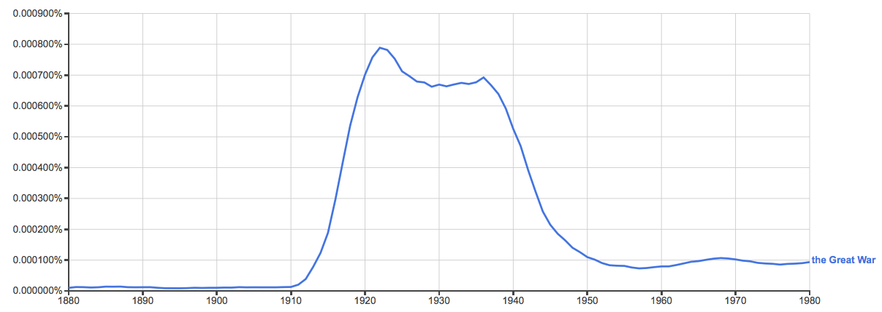
Ngram figures can be powerful

Slide 18
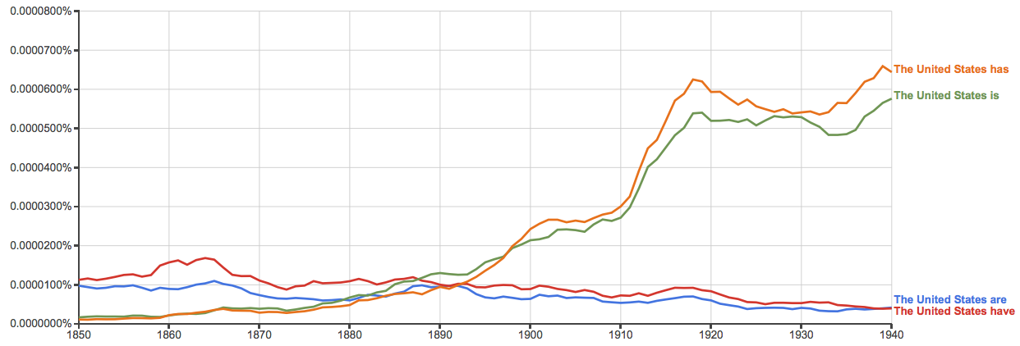

Slide 19
“liberal” from 1680-1769

Slide 20
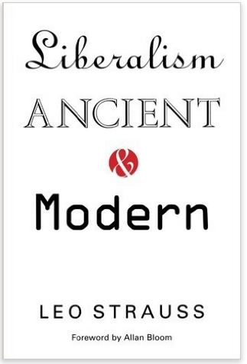
liberal – “becoming a free man as distinguished from a slave.”
“… liberality is a virtue concerned with the use of wealth and therefore especially with giving: the liberal man gives gladly of his own in the right circumstances because it is noble to do so…”
“Liberality is … one aspect of … human excellence or being honorable or decent.”

Slide 21
Samuel Johnson 1755
liberal arts, liberal sciences, liberal professions

Slide 22
But suddenly…
The word liberal was put to use in a quite particular political way.

Slide 23
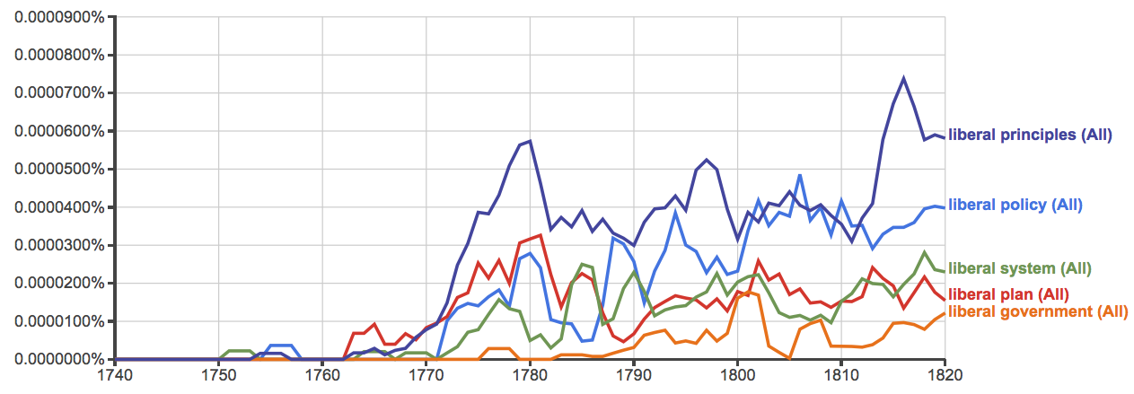

Slide 24
Two perspectives on the inception of a political meaning
The importation thesis
Hayek’s thesis

Slide 25
The importation thesis: That liberal-in-a-political-sense was imported into Britain from the Continent
Jörn Leonhard
Daisy Hay (2008, 310, 312)
David M. Craig (2012, 469, 481ff)
R.R. Palmer and Joel Colton (1984, 428)
J. Salwyn Shapiro (1958, 9)
Auguste Nefftzer (implied, 1863)
James Fitzjames Stephens (1862)
An 1823 article (by R. Southey?) in the Tory journal Blackwood’s

Slide 26
Hayek thesis
“It is often suggested that the term “liberal” derives from the early nineteenth-century Spanish party of the liberales. I am more inclined to believe that it derives from the use of the term by Adam Smith in such passages as W.o.N., II, 41: “the liberal system of free exportation and free importation” and p. 216: “allowing every man to pursue his own interest his own way, upon the liberal plan of equality, liberty, and justice.” (Hayek 1960, 530 n13)

Slide 27
Hayek was right

Slide 28
The chief originators
William Robertson Adam Smith
(1721-1793) (1723-1790)

Slide 29
William Robertson
The Scottish historian and Principal of the University of Edinburgh, and leader in the Church of Scotland.
Some examples:
1769, The History of the Reign of the Emperor Charles V, Volume 1:
“The revival of the knowledge and study of the Roman law, co-operated with the causes which I have mentioned, in introducing more just and liberal ideas concerning the nature of government, and the administration of justice.”
“Every little community subsisting on its own domestick stock, and satisfied with it, is either unacquainted with the states around it, or at variance with them. Society and manners must be considerably improved, and many provisions must be made for public order and personal security, before a liberal intercourse can take place between different nations.”

Slide 30
William Robertson
“When the manners of the European nations became more gentle, and their ideas more liberal, slaves who married without their master's consent, were subjected only to a fine.”
“...but the ideas are singular, and much more liberal and enlarged than one could expect in that age. A popular monarch of Great Britain could hardly address himself to parliament, in terms more favourable to publick liberty. There occurs in the History of France a striking instance of the progress which the principles of liberty had made in that kingdom, and of the influence which the deputies of towns had acquired in the States General.”
“That may have been the case, but these men possessed the confidence of the people ; and the measures which they proposed as the most popular and acceptable, plainly prove that the spirit of liberty had spread wonderfully, and that the ideas which then prevailed in France concerning government were extremely liberal.”

Slide 31
William Robertson
“...the spirit and zeal with which they contended for those liberties and rights without which it is impossible to carry on commerce to advantage. The vigorous efforts of a society of merchants attentive only to commercial objects, could not fail of diffusing over Europe new and more liberal ideas concerning justice and order whereever they settled.”
“The Aragonese were no less solicitous to secure the personal rights of individuals, than to maintain the freedom of the constitution ; and the spirit of their statutes with respect to both was equally liberal.”
From a 1776 letter to Smith:
“You have formed into a regular and consistent system one of the most intricate and important parts of political science, and if the English be capable of extending their ideas beyond the narrow and illiberal arrangements introduced by the mercantile supporters of Revolution principles, and countenanced by Locke and some of their favourite writers, I should think your Book will occasion a total change in several important articles both in police and finance. ...many of your observations concerning the Colonies are of capital importance to me. I shall often follow you as my Guide and instructor.”

Slide 32
William Robertson
A year later in 1777, Robertson published his History of the Discovery and Settlement of America, in which he wrote:
"What may be the effects of opening this communication between countries destined by their situation for reciprocal intercourse cannot yet be determined by experience. They can hardly fail of being beneficial and extensive. The motives for granting this permission are manifestly no less laudable than the principle on which it is founded is liberal; and both discover the progress of a spirit in Spain, far elevated above the narrow prejudices and maxims on which her system for regulating the trade and conducting the government of her colonies was originally founded. ...The nation has adopted more liberal ideas, not only with respect to commerce, but domestic policy."

Slide 33
Smith WN passages:
“Were all nations to follow the liberal system of free exportation and free importation, the different states into which a great continent was divided would so far resemble the different provinces of a great empire. As among the different provinces of a great empire the freedom of the inland trade appears, both from reason and experience, not only the best palliative of a dearth, but the most effectual preventative of a famine; so would the freedom of the exportation and importation trade be among the different states into which a great continent was divided. The larger the continent, the easier the communication through all the different parts of it, both by land and by water, the less would any one particular part of it ever be exposed to either of these calamities, the scarcity of any one country being more likely to be relieved by the plenty of some other. But very few countries have entirely adopted this liberal system.”

Slide 34
Smith WN passages
“The industry and commerce of a great country he [Mr. Colbert, the famous minister of Louis XIV] endeavoured to regulate upon the same model as the departments of a publick office; and instead of allowing every man to pursue his own interest his own way, upon the liberal plan of equality, liberty and justice, he bestowed upon certain branches of industry extraordinary privileges, while he laid others under as extraordinary restraints.”

Slide 35
Smith WN passages
On the system of the Physiocrats: “According to this liberal and generous system, therefore, the most advantageous method in which a landed nation can raise up artificers, manufacturers and merchants of its own, is to grant the most perfect freedom of trade to the artificers, manufacturers and merchants of all other nations.”

Slide 36
Smith WN passages
“...in representing the wealth of nations as consisting, not in the unconsumable riches of money, but in the consumable goods annually reproduced by the labour of the society; and in representing perfect liberty as the only effectual expedient for rendering this annual reproduction the greatest possible, its doctrine seems to be in every respect as just as it is generous and liberal.”
“That in every profession the fortune of every individual should depend as much as possible upon his merit, and as little as possible upon his privilege, is certainly for the interest of the public. It is even for the interest of every particular profession, which can never so effectually support the general merit and real honour of the greater part of those who exercise it, as by resting on such liberal principles.”

Slide 37
Smith WN passages
“… [T]he principal attributes of villanage and slavery being thus taken away from them [that is, the burghers/townspeople living in the towns treated by the sovereign as Smith describes] they now, at least, became really free in our present sense of the word Freedom … [I]n this manner [the sovereigns of all the different countries of Europe] voluntarily erected a sort of independent republicks in the heart of their own dominions. … The princes who lived upon the worst terms with their barons, seem accordingly to have been the most liberal in grants of this kind to their burghs.” (400-402)

Slide 38
Smith WN passages
“But though the policy of Great Britain with regard to the trade of her colonies has been dictated by the same mercantile spirit as that of other nations, it has, however, upon the whole, been less illiberal and oppressive than that of any of them.”
“In the different ways in which this monopoly has been exercised, consists one of the most essential differences in the policy of the different European nations with regard to their colonies. The best of them all, that of England, is only somewhat less illiberal and oppressive than that of any of the rest.”

Slide 39
liberal in British Officialdom
King George III’s Speech opening 3rd session of Parliament in 1782: “The liberal principles …”
Henry Mackenzie in Parliament 1784: “the same liberal principle”
Many more found in Parliamentary History of England … to the Year 1803

Slide 40
Continuity
After 1776 the Brits (esp. Scots) kept the “liberal” ball rolling.

Slide 41
Dugald Stewart
(1753-1828)
“At Edinburgh he lectured on the principles of government and political economy in 1800–8 to an influential group of students who were to do much to form Whig and Tory opinion in the early 19th century.” (Phillipson in New Palgrave)

Slide 42
In Stewart’s “Account” of Smith
“those liberal views of commercial policy”
“the liberal policy of modern times”
“Such are the liberal principles”
“his liberal system”
“Some of these liberal principles found their way into France”

Slide 43
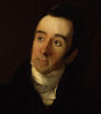
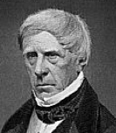
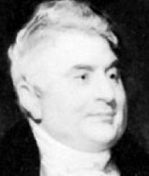
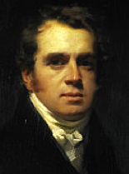
Started in 1802. Supported Whig party and liberal politics.
Dugald Stewart “exercised the dominant influence on the reviewers” (Fontana, 4)
Editor 1802-1829
Francis Jeffrey
1773-1850
Henry Brougham
1778-1868
Sydney Smith
1771-1845
Francis Horner
1778-1817

Slide 44
John Ramsay McCulloch (1789-1864)
Another Scot.
“arguably the first professional economist” (source)
“Political Economy” entry in 1824 Encyclopedia Britannica + his 1824 Disc., 1825 Princ.s, 1821 ER article,.
It is long and teeming with use of political “liberal.”
The piece was reprinted in US in 1825.

Slide 45
Early translations (full or abridged)
Robertson’s Charles V:
French: 1771
German: 1770-71
Smith’s WN (Lai 404ff):
French: 1778/79, 1779/81, 1790, 1802
Spanish: 1792*, 1794
Italian: 1790/91
German: 1776/78/92, 1794/95/96
Swedish: Parts 1799-1801
Danish: 1779/1780

Slide 46
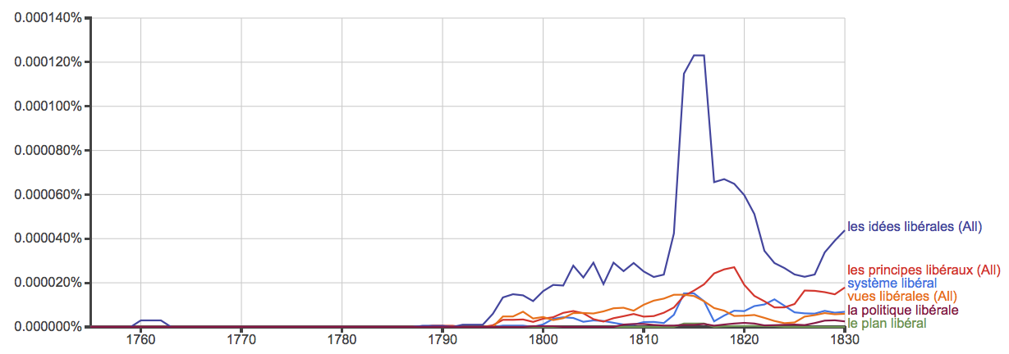
France

Slide 47
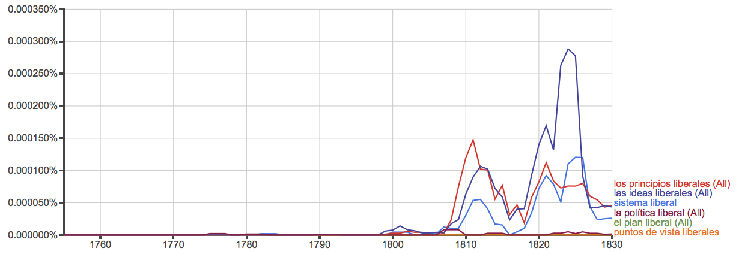
Spain

Slide 48
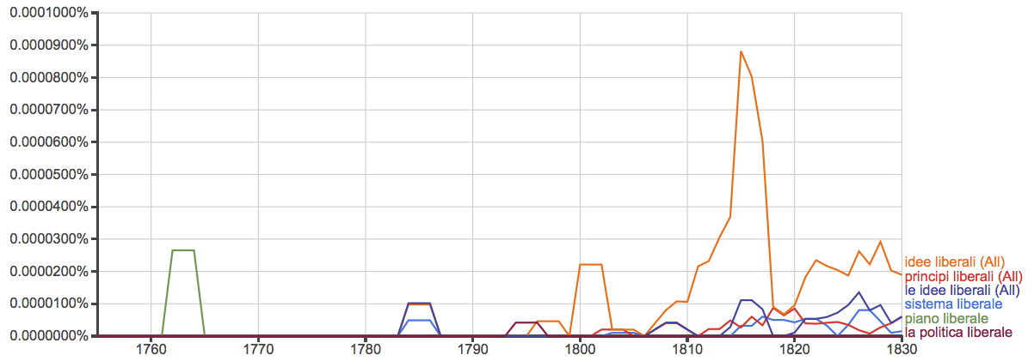
Italy

Slide 49
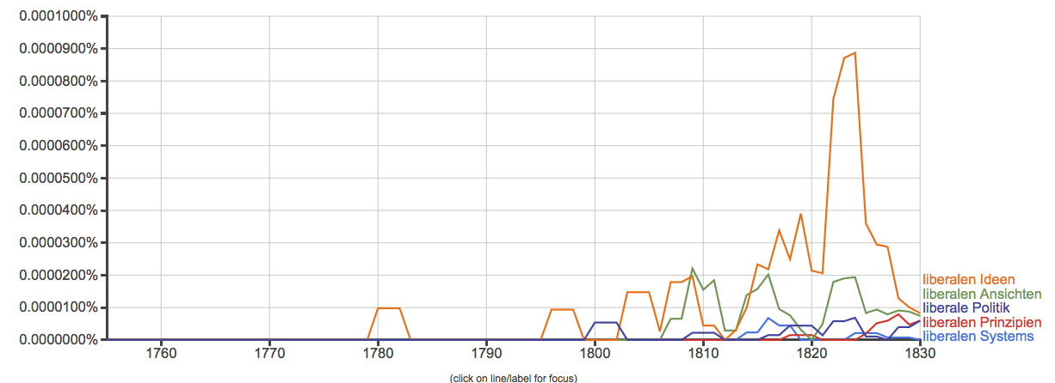
Germany

Slide 50
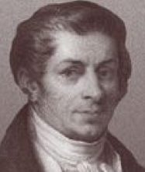
France
Early translations of Charles V and WN.
Smith in France 1764-66, friends in France.
David Hume in France 1734-37, 1763-66.
The French engaged Smith.
Jean-Baptiste Say (1767-1832)
“From 1794 to 1800 Say edited a periodical entitled La Decade philosophique, litteraire, et politique, in which he expounded the doctrines of Adam Smith. … In 1803 appeared Say's principal work, the Traité d'économie politique …” (Wikipedia)

Slide 51
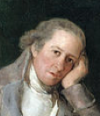
Spain
Jovellanos painted by Goya
Gaspar Melchor de Jovellanos (1744-1811)
Lawyer, author, statesman
“Though Jovellanos’ liberalism was not the product of a single influence, Smith impressed him profoundly.” (R.S. Smith in Lai p. 315)
Read WN four times.
By 1781 read and admired Charles V.
He was a leader of the Liberales!

Slide 52
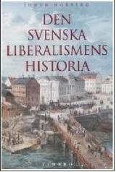
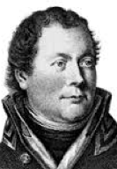
Sweden
Georg Adlersparre:
Highly Smithian
Translated parts of WN
Called himself “liberal” in 1804.
Led the ousting of the king and Liberal wing of the 1809-1810 constitutional convention!
Georg Adlersparre
1760-1835

Slide 53
Liberalism

Slide 54
Was liberty really the soul of original liberalism?

Slide 55
How was liberal reform achieved?
Many say that Smith &co persuade the aristocrats and elites.
Quotations from:
Dugald Stewart
John Millar
Joseph Schumpeter
Ludvig von Mises

Slide 56
Dugald Stewart: By the end of his life Smith “had not only the satisfaction of seeing the opposition [to his policy ideas] gradually subside, but to witness the practical influence of his writings on the commercial policy of his country.” (EPS 324)
John Millar: “the world is much indebted to” philosophers esp. Smith. “The universal approbation which this new doctrine has met with in the higher classes of mercantile people”… is “a decisive proof…of the enlarged views of political economy, by which the present age has become so eminently distinguished” (p.717)

Slide 57
Later commentators:
Schumpeter, speaking of “the English case” in particular:
“The aristocratic element continued to rule the roost right to the end of the period of intact and vital capitalism… [The aristocratic element] made itself the representative of bourgeois interests and fought the battles of the bourgeoisie; it had to surrender its last legal privileges; but with these qualifications, and for ends no longer its own, it continued to man the political engine, to manage the state, to govern” (CSD 136-37).

Slide 58
Mises:
“The most amazing thing concerning the unprecedented change…is the fact that it was accomplished by a small number of authors and a hardly greater number of statesmen who had assimilated their teachings. … Western civilization adopted capitalism upon recommendation…of a small elite.” (Anti-cap 34-35)

Slide 59
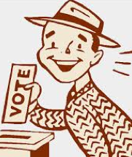
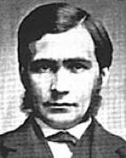
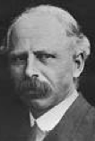
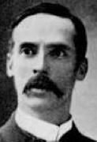
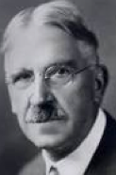
Three faces of “liberal”
The presumption of liberty
Democratism
The governmentalization of social affairs
T.H. Green L.T. Hobhouse J.A. Hobson J. Dewey J. Stiglitz

Slide 60
Britain vs. Continent
In Britain after 1690/1707 is a stable polity, a nation-state with a stable government.
On continent, often, liberals felt the need to change the polity as such.
The British liberal authors are more focused liberal policy reform.

Slide 61
Stewart: Smith is about natural liberty, not democratism
“The progress already made in this science…has been sufficient to shew, that the happiness of mankind depends, not on the share which the people possess, directly or indirectly, in the enactment of laws, but on the equity and expediency of the laws that are enacted.”
“[T]he most celebrated works … by Smith, Quesnai, Turgot, Campomanes, Beccaria, and others, have aimed at the improvement of society,--not by delineating plans of new constitutions, but by enlightening the policy of actual legislators.”
(EPS 310, 311)

Slide 62
Was Smith a democrat?
No, not particularly.

Slide 63
Liberalism declined very suddenly after 1880
Fabian wrote in 1894:
“Laissez-faire individualist political philosophy is dead. In vain does poor Mr. Spencer endeavor to stem the torrent. His political ideas are already as antiquated as Noah’s ark. I do not know a single one of the younger men in England who is influenced by them in the slightest degree, though one hears of one occasionally, just as one hears of a freak in a dime museum.”

Slide 64
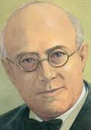
Why did it decline so suddenly?
Many said it declined because it failed.
Other explanations … but can’t go into here.

Slide 65
The mentality of governmentalization

Slide 66
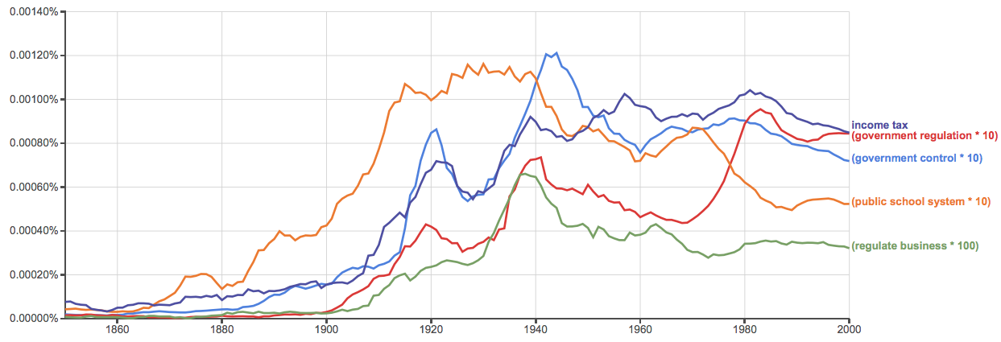
Government institutions

Slide 67
Words change or lose meaning
liberal
liberty
freedom
rights
justice
property
contract
equality, equity
law, rule of law

Slide 68
Three faces of “liberal”
The presumption of liberty
Democratism
The governmentalization of social affairs
T.H. Green L.T. Hobhouse J.A. Hobson J. Dewey J. Stiglitz

Slide 69
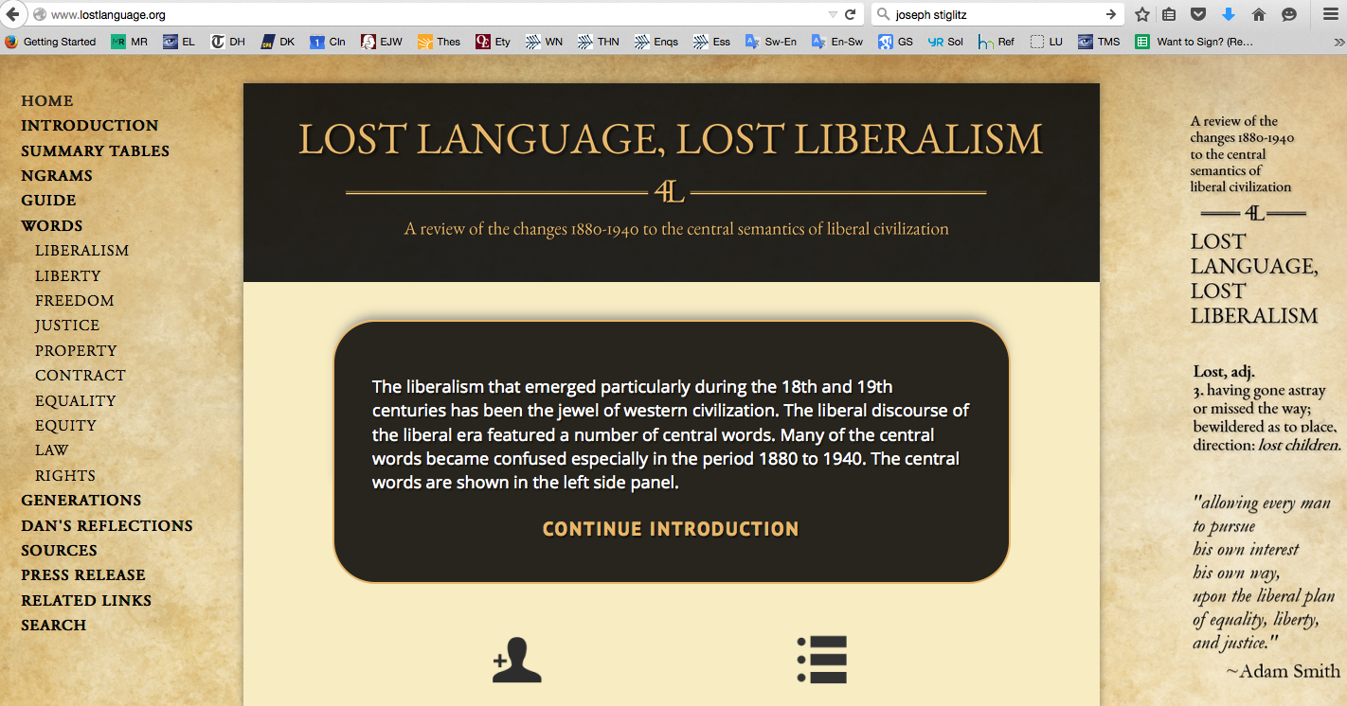

Slide 70
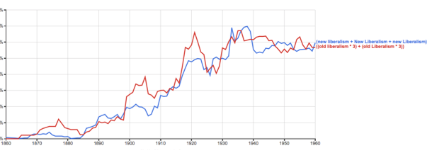
New Liberalism

Slide 71
Suitable terms
left
progressive
social democratic

Slide 72
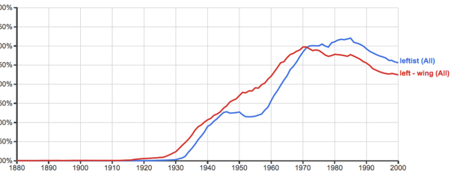
leftist, left-wing

Slide 73
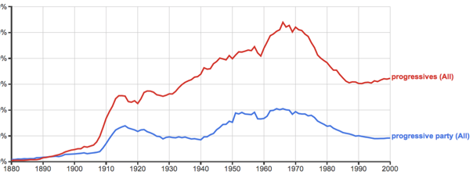
progressive

Slide 74
H.L. Mencken, 1926
“The Progressive is one who is in favor of more taxes instead of less, more bureaus and jobholders, more paternalism and meddling, more regulation of private affairs and less liberty.”

Slide 75
progress is goal oriented
Liberalism is a philosophy of improvement, betterment, not progress.

Slide 76
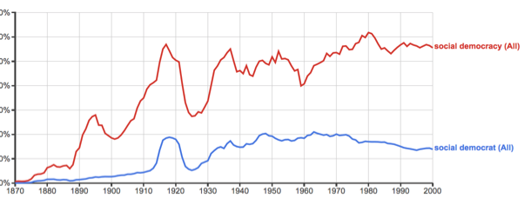
social democratic

Slide 77
Conclusion
The word liberal
connotes generous, noble, open-minded
connotes learning and invention: liberal arts, liberal sciences, liberal professions
relates to liberty
is the name that emerged for the crown jewel of human history, the presumption of liberty
still pretty much means classical liberal in Australia, New Zealand, most of Europe, Asia, and South and Central America
even in US and Canada, still shows is provenance in liberalize, liberalization

Slide 78
To oppose “liberals” is like opposing modern, open-society.
We call oppressive societies “illiberal.”
Calling leftsts “liberals” is the gift that keeps on giving.

Slide 79
Thank you for your attention.

